Slide 1
Event Bus
By Varsha Rani

Slide 2
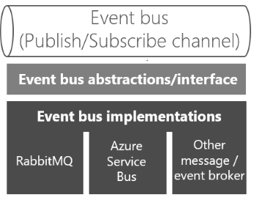
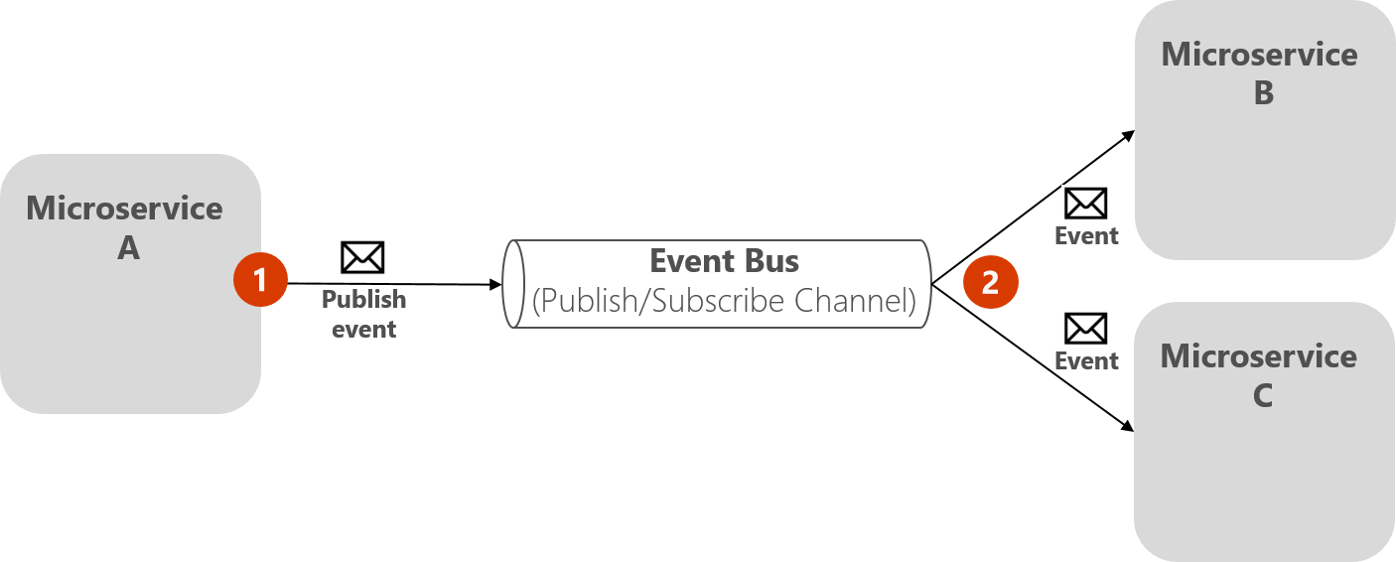
Why we need Event bus?
Event buses are useful when you don't want components to depend on each other. Instead of a component having many references to other components, it can just send Events to an Event bus and does not have to worry about who will take care of them.
What is Event bus?
An event bus allows publish/subscribe-style communication between microservices without requiring the components to explicitly be aware of each other. It is a pipeline that receives events. Rules associated with the event bus evaluate events as they arrive. Each rule checks whether an event matches the rule's criteria. Developer associate a rule with a specific event bus, so the rule only applies to events received by that event bus.
An event bus is typically composed of two parts:
The abstraction or interface.
One or more implementations.

Slide 3
public interface IEventBus
{
void Publish(IntegrationEvent @event);
void Subscribe<T, TH>()
where T : IntegrationEvent
where TH : IIntegrationEventHandler<T>;
void SubscribeDynamic<TH>(string eventName)
where TH : IDynamicIntegrationEventHandler;
}

